Slide 1

CSA5103-CRYPTOGRAPHY AND NETWORK SECURITY
Review-1
Trust-Aware Secure File Transfer Using Hybrid Cryptography
Supervised By,
Dr. R.Dharani
Presented by,
Afsiya Banu.A-192521466
Yashmita G-192511032
Shobana.T-192521188
Chavidi mahi-192312162

Slide 2


Agenda
Introduction
Literature Survey
Problem Definition
Objectives
Proposed Architecture
Modules Introduction

Slide 3
Introduction
Secure File Transfer: Enables users to share files securely while protecting sensitive information from unauthorized access.
Trust-Based Authentication: Verifies user identity and evaluates predefined trust conditions before granting access.
Hybrid Cryptography: Combines AES encryption for file protection with RSA encryption to securely protect the AES key.
Data Integrity Verification: Detects unauthorized modifications to files using cryptographic hashing.
Threat Detection and Access Control: Restricts unauthorized access and generates alerts when suspicious activities are detected.

Slide 4
Literature Survey
No. | Year | Research Paper | Methodology | Research Gap
1 | 2022 | Secure File Storage on Cloud Using Hybrid Cryptography | Combined AES, ElGamal encryption, and SHA-256 to improve cloud data confidentiality and integrity. | Limited emphasis on trust-based user authentication and dynamic threat response.
2 | 2023 | A Survey on Hybrid Cryptography for Secure File Storage on the Cloud | Explored AES and RSA for file encryption, secure key management, authentication, and file sharing. | Trust evaluation and continuous integrity monitoring require further consideration.
3 | 2024 | Secure File Storage on Cloud Using Hybrid Cryptography | Integrated AES-256, RSA, and SHA-256 to protect sensitive cloud data and verify integrity. | Additional mechanisms are needed to evaluate user trust and respond to suspicious activities.
4 | 2024 | AES-RSA: An Innovative Hybrid Security Framework for File Authentication, Integrity, and Data Secrecy Model | Combined AES and RSA to strengthen data confidentiality, key management, and file integrity. | A comprehensive trust-aware access control mechanism is not the primary focus.
5 | 2025 | A Hybrid ECC-AES Encryption Framework for Secure and Efficient Cloud-Based Data Protection | Combined Elliptic Curve Cryptography (ECC) and AES to improve cloud data protection and encryption efficiency. | Integrating trust-based authentication, secure file transfer management, and dynamic threat response remains an area for further development.

Slide 5


Problem Definition
Traditional file transfer systems face security challenges, including unauthorized access, data theft, and file tampering during transmission. Conventional encryption methods may not provide a complete solution for secure key management, user trust evaluation, and continuous integrity verification.
Therefore, a secure file transfer system is required to authenticate users based on trust, protect files using hybrid cryptography, verify data integrity, and detect suspicious activities.
The proposed Trust-Aware Secure File Transfer Using Hybrid Cryptography aims to address these challenges by integrating trust-based authentication, AES and RSA encryption, continuous integrity verification, and dynamic threat response to ensure secure, reliable, and confidential file transmission.

Slide 6
Objectives
Trust-Based User Authentication: To verify user identities and evaluate trust levels before granting access to file transfer services.
Hybrid Cryptographic Encryption: To implement AES for secure file encryption and RSA for protecting the AES encryption key.
Data Integrity Verification: To detect unauthorized modifications to files using cryptographic hash functions such as SHA-256.
Dynamic Threat Detection: To identify suspicious user activities and restrict access when potential security threats are detected.
Secure File Transfer: To ensure the confidentiality, integrity, and controlled sharing of files between authorized users.
Secure File Recovery and Management: To maintain secure file records and support controlled file retrieval while preserving data integrity.

Slide 7
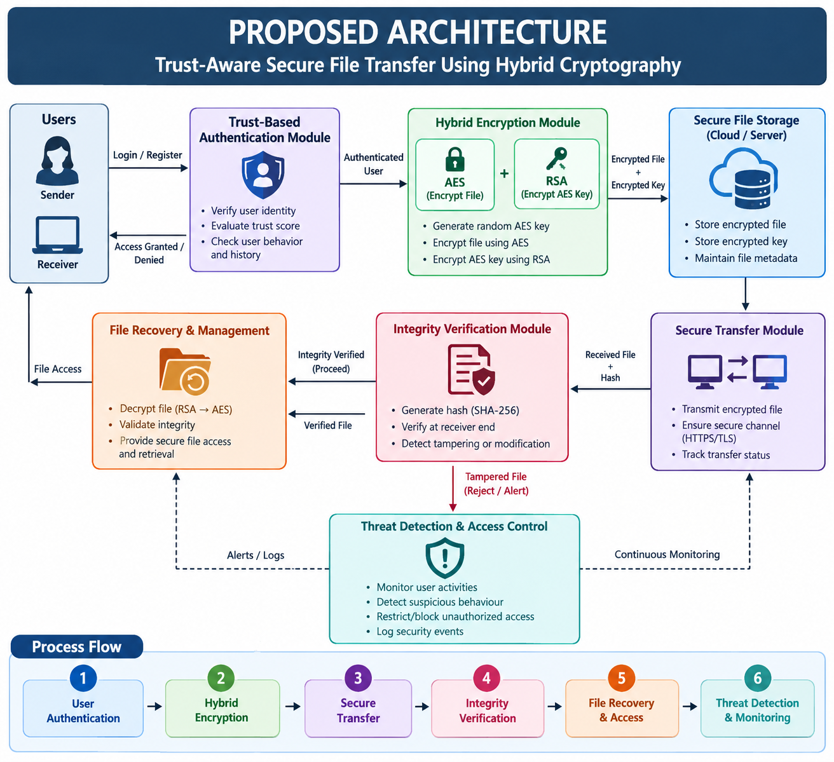

Slide 8
MODULES INTRODUCTION
Module 1: Trust-Based User Authentication and Secure Access Control
Verifies user identity, evaluates trust levels, and grants or denies access based on authentication results and security policies.
Module 2: Hybrid Encryption and Secure File Transfer
Uses AES to encrypt files and RSA to protect the AES encryption key, enabling confidential and secure file transmission between authorized users.
Module 3: Continuous Integrity Verification and Dynamic Threat Response
Uses SHA-256 hashing to verify file integrity, detect unauthorized modifications, and trigger appropriate security responses when suspicious activities are identified.
Module 4: Secure File Recovery and Transfer Management
Manages secure file retrieval, decryption, transfer status, and file access records while ensuring that only authorized users can access verified files.

Slide 9
Thank You

